Slide 1


Data Engineer Project
Rita Uzoka

Slide 2
Problem Statement
Operational Inefficiencies
Resource allocation and prioritization
Data Complaint and regulation

Slide 3
Objectives
Ensure data compliance and regulation.
Provide the interested public with access to the data, which illustrates how the city’s budget is being used for each municipal employee’s salary and overtime.
Examine the distribution of the city’s financial resources and the percentage of the budget that is going for overtime.

Slide 4
Benefit
Reusable ETL Process
An analysis of the allocation of financial resources.
Public accessibility and Transparency of data.

Slide 5
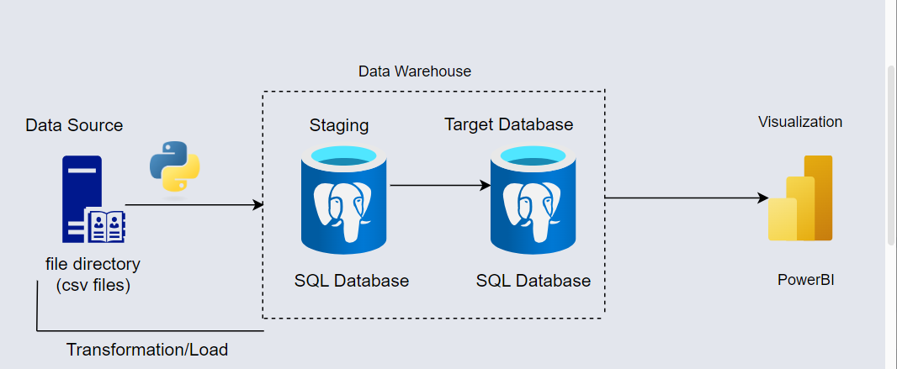
Solution Architecture

Slide 6
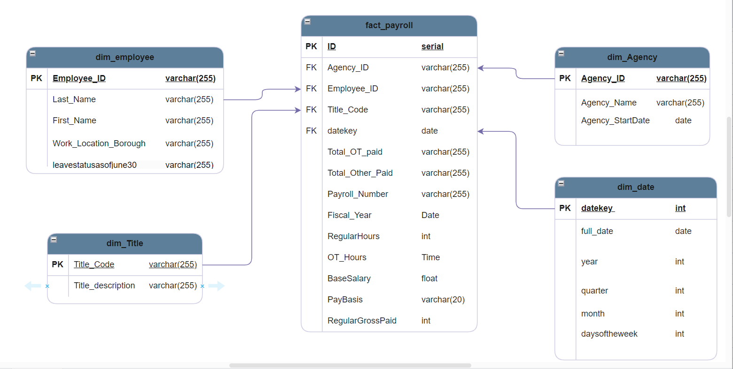
ERD Diagram

Slide 7
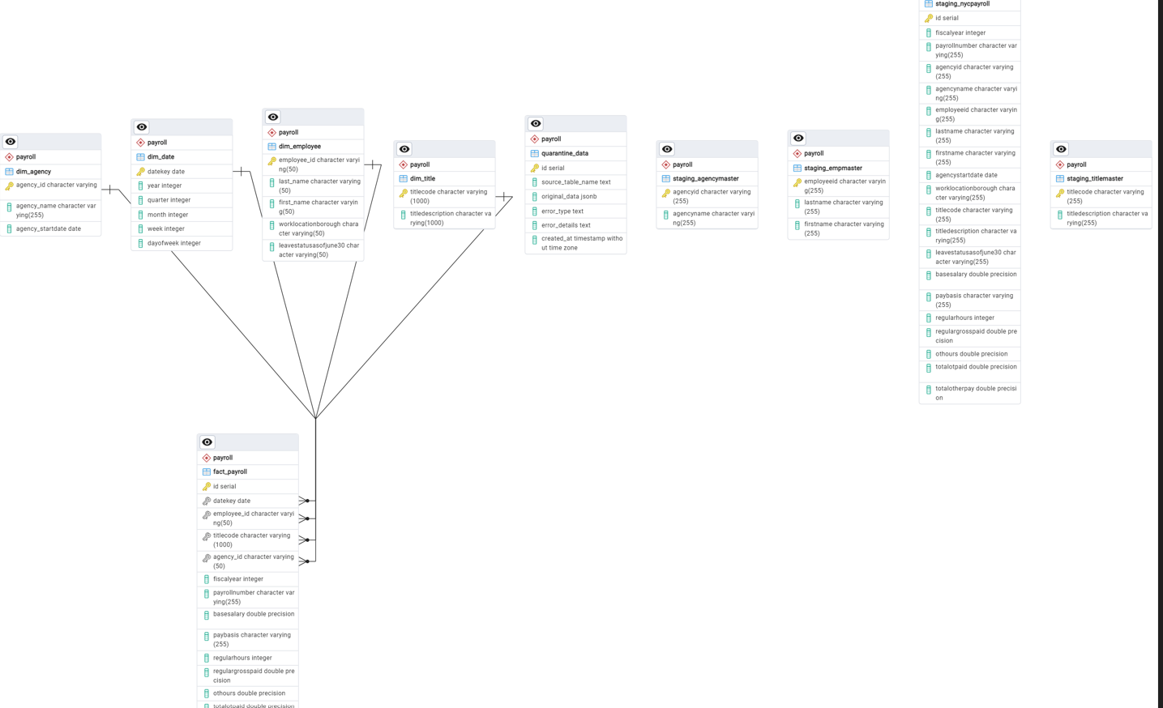
ERD Diagram

Slide 8
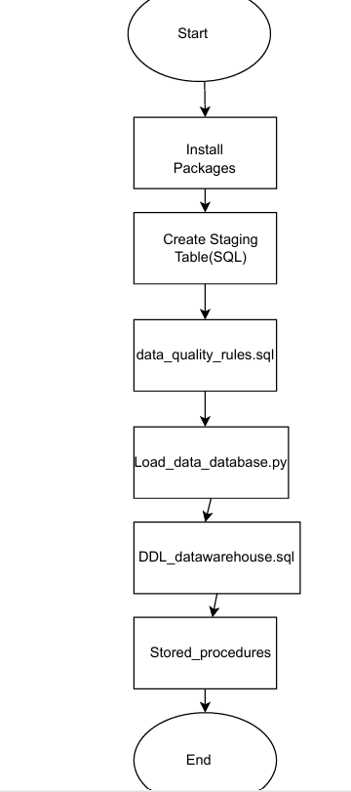
Project Workflow

Slide 9
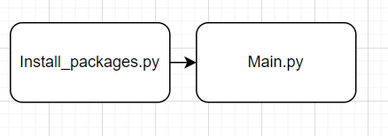
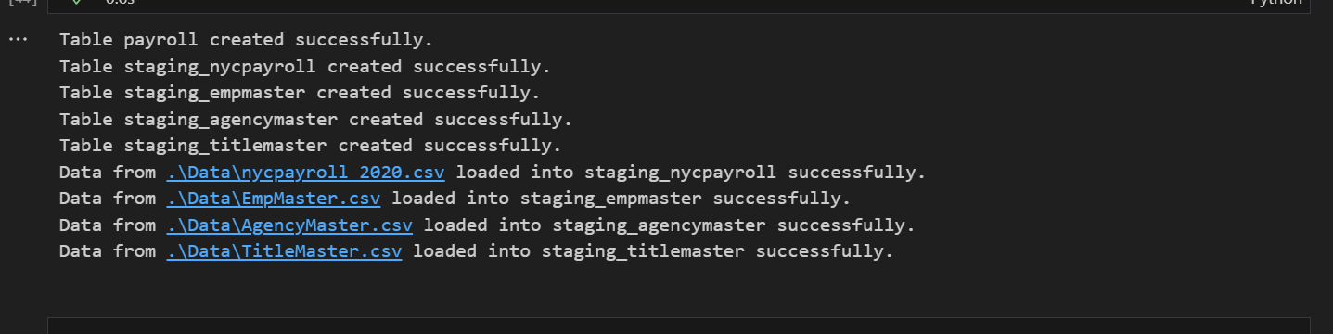
Project Data Pipeline Flow

Slide 10
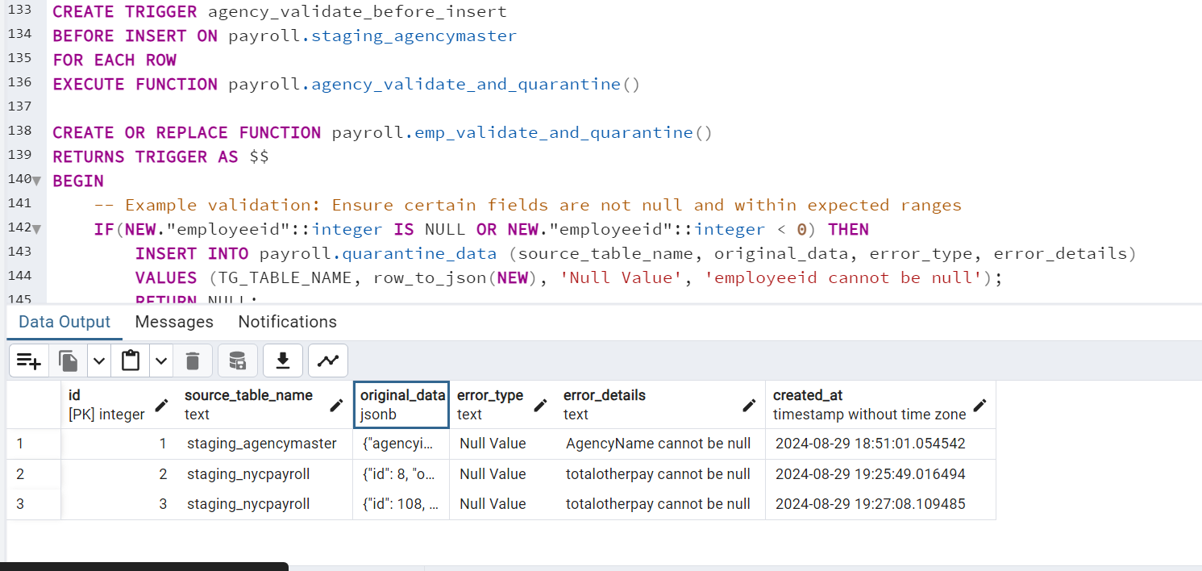
Data Validation

Slide 11
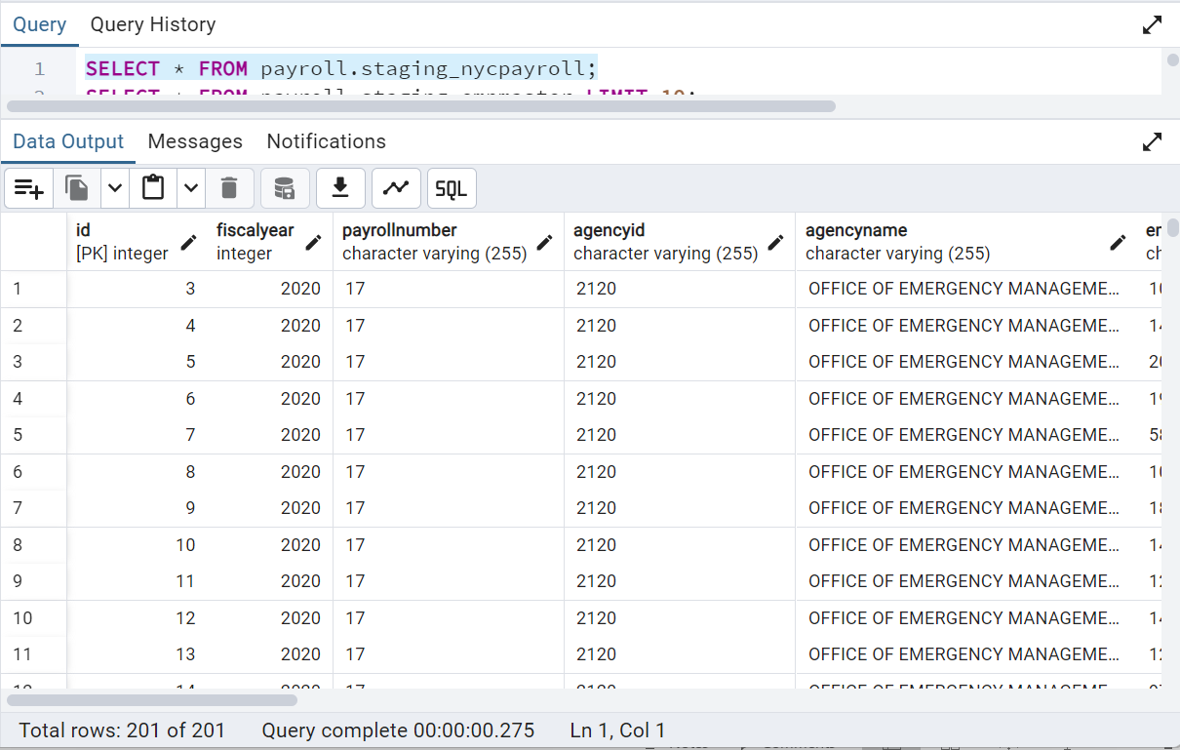
Data Loaded in PostgreSQL Database

Slide 12
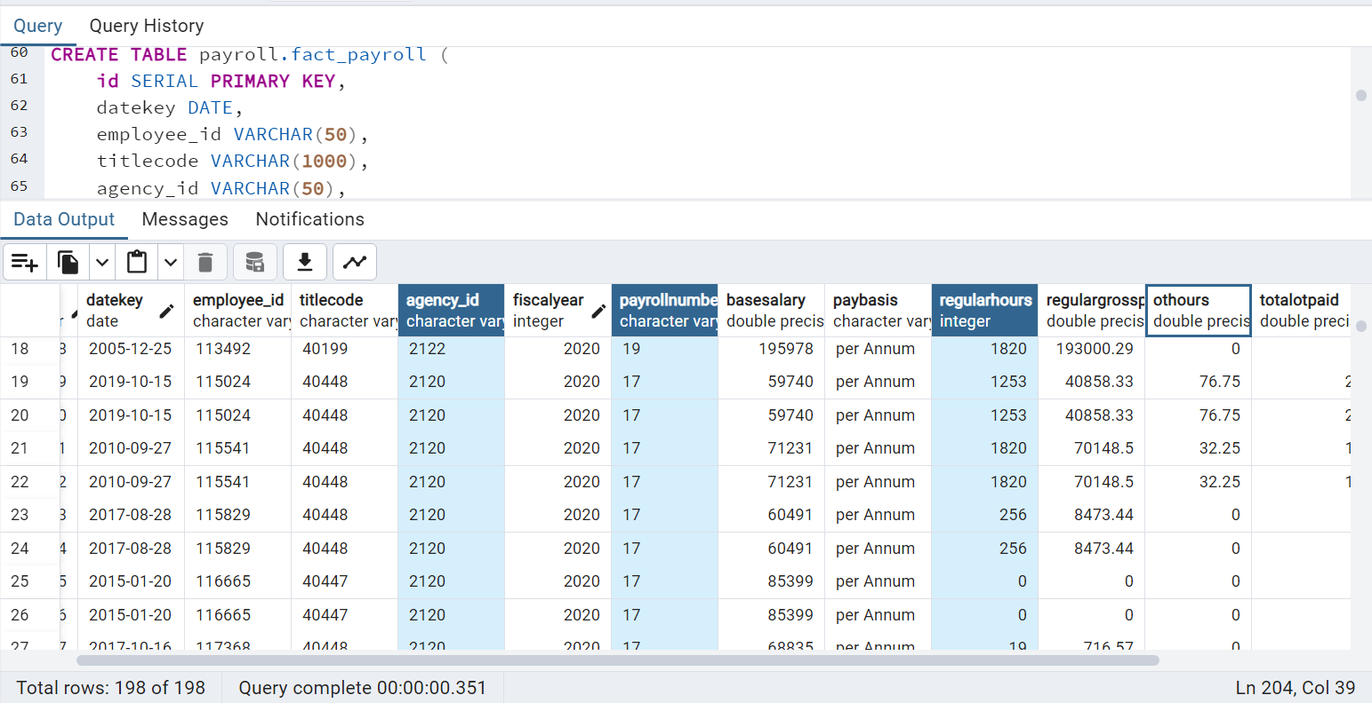
Data Warehouse Data Loaded in PostgreSQL Database

Slide 13
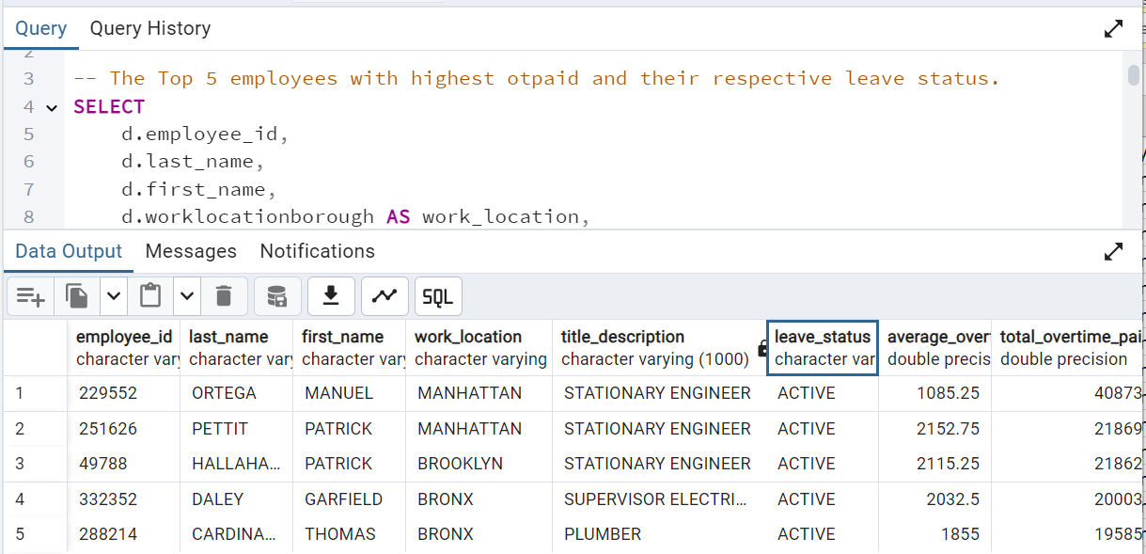
Project Analysis

Slide 14
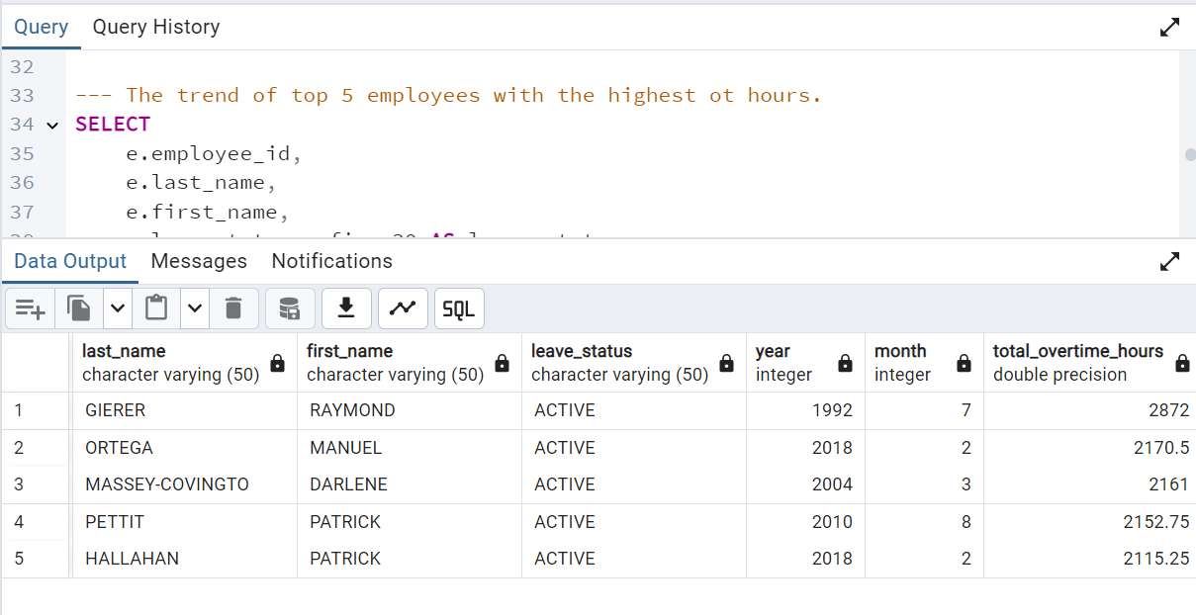
Project Analysis

Slide 15
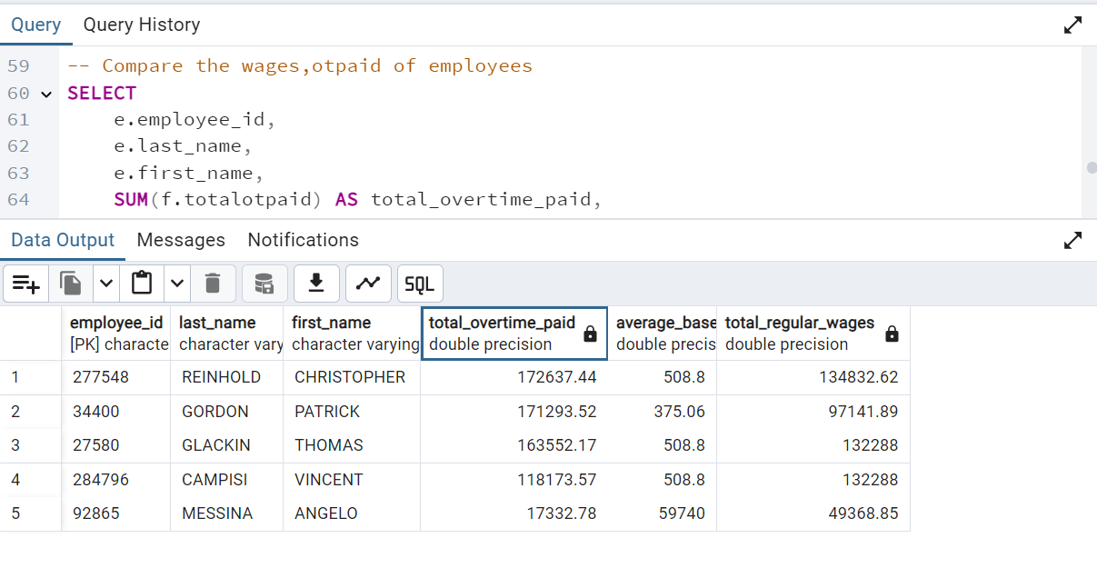
Project Analysis

Slide 16
Recommendation
Employees tend to be paid more overtime than wages ,this could lead to work stress and burn out
Based on the high cost of overtime, staffing adjustment is advised
Stationary engineers constantly earned high otpaid which might possible mean work in balance.

